Slide 1


Bank Loan Case Study
-Ranapratap Ghosh

Slide 2

Project Description:
This project is based on EDA implementation in real world business scenario. The program also evolves around an understanding of risk in , banking and financial services, and an understanding of how data can be used to reduce the risk of losing money when lending customers.
There are two types of risks associated with the bank's decision: If the applicant is likely to repay the loan, refusal of the loan will result in the loss in business for the company. Approval of the loan number,will cause a loss of money for the company if the applicant is unable to repay the loan, that is, if it cannot pay.

Slide 3

Approach & Tech-Stack Used
For this project, the Jupyter Notebook was used to run queries and to create plot(graph) with the help of the Python3.0 scripting language. Jupyter Notebook is a browser-based tool for interactive document authoring that combines descriptive, mathematical, computational and 's rich business features.
Microsoft Powerpoint
Link for the Python File - https://drive.google.com/file/d/1IOXjpS96qKICs_5xQT3ysZ9zI-bibozk/view?usp=sharing

Slide 4

Cleaning The Data
Cleaning The Data is One of the major part of starting any Data analysis.
We got 2 Main database for this Project Application Data and Previous Application Data.
According To the requirement of the Project, We need to identify the least required column in the dataset.

Slide 5
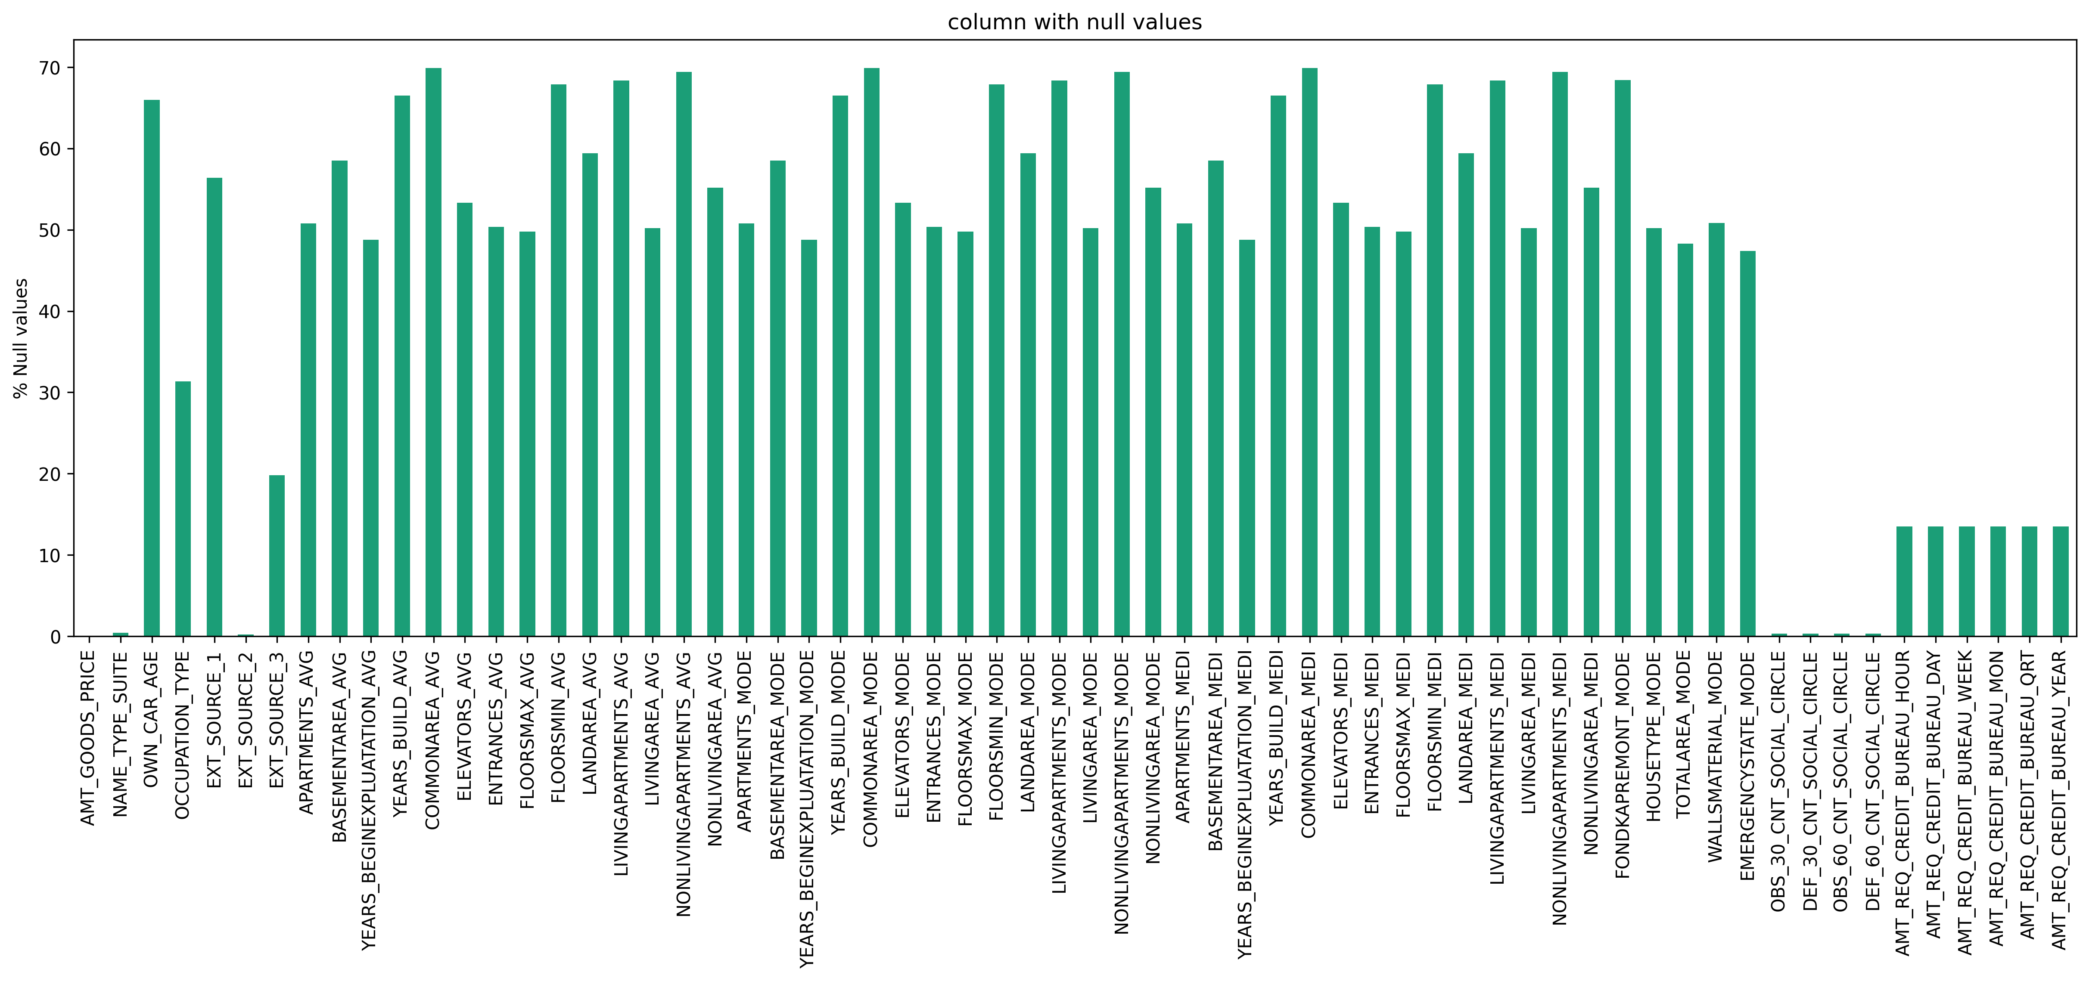
Cleaning The Data
df_current_application.isnull().sum() this function was used to identify the count of missing values.
Then We Created Two Segments of columns that have data missing more than 25% of the data and columns that are missing more than 40% of the data.

Slide 6
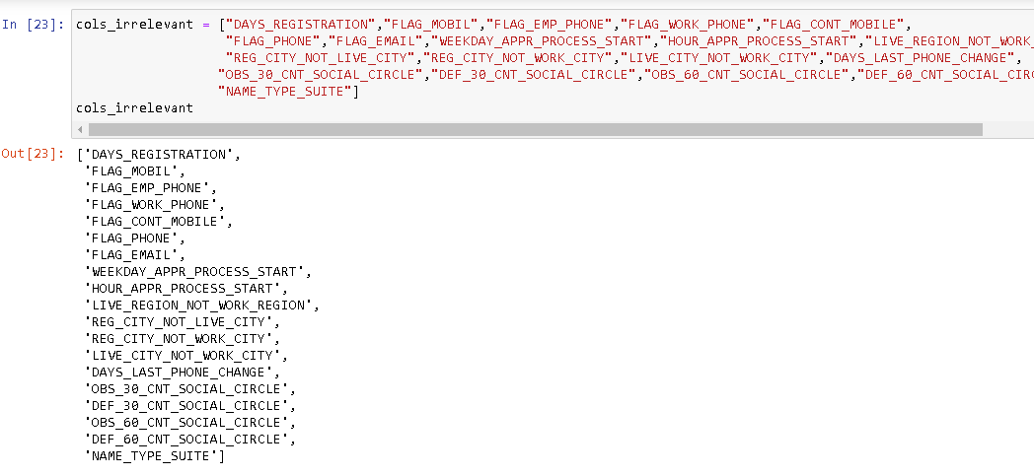
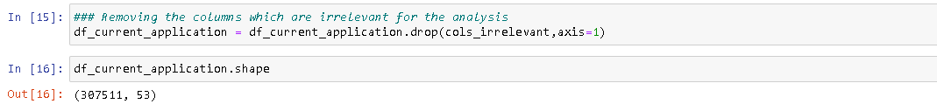
Cleaning The Data
We created a variable for irrelevant columns and stored the columns found irrelevant for the analysis and drop them.

Slide 7
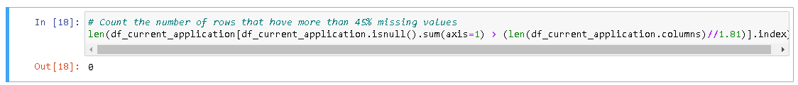
Cleaning The Data
Then We check that if there are any other column there that have 40% or more null values. But there are no columns that has more than 45% null values.

Slide 8
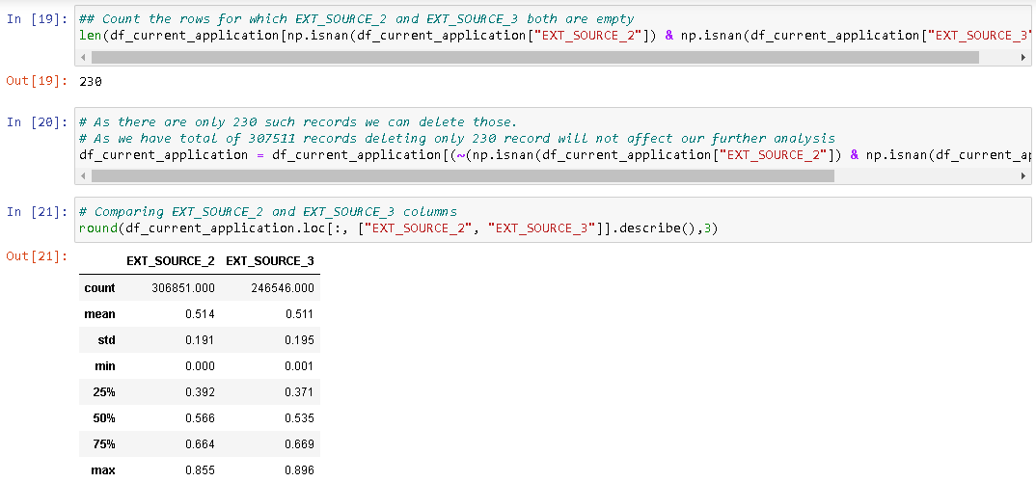
Cleaning The Data(Row Level)
In this case We Identify is there any missing values in row level. We created two indices as "EXT_SOURCE_2“ and "EXT_SOURCE_3"

Slide 9
Cleaning The Data
Two treat the missing values in row level, we imputed the missing values with the mean value we got from "EXT_SOURCE_2“ and "EXT_SOURCE_3"

Slide 10
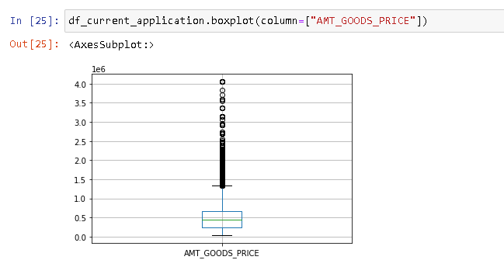
Cleaning The Data(Row Level)
Using Box_plot to analyze AMT_GOODs_PRICE

Slide 11
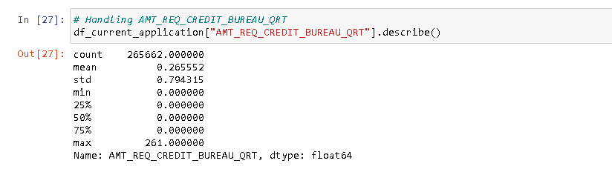
Cleaning The Data(Row Level)
We have 5 questions that credit bureaus ask about customers. It is not necessary to count the hour or day before the application date, or the short hours in a week. On the other hand, it is not very useful if we calculate the number in the long run. So if we use the three-month period, that works for us, it's neither short nor long. So, now we need to do two things:-

Slide 12
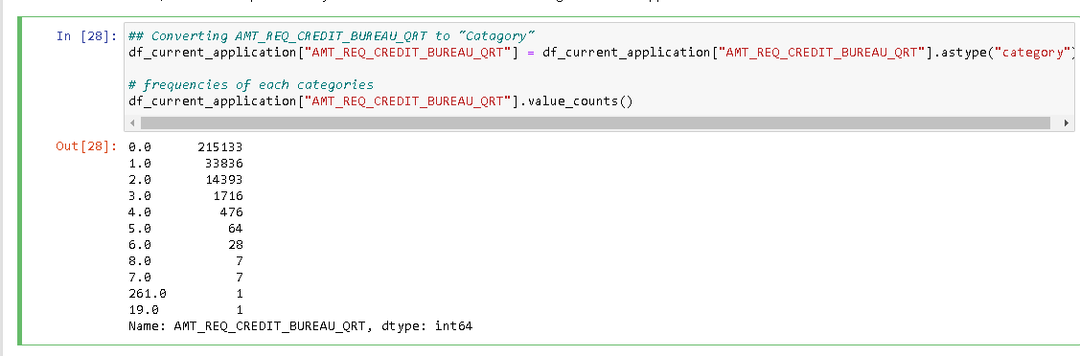
Cleaning The Data(Row Level)

Slide 13
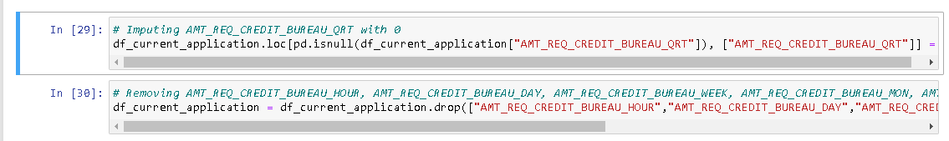
Identify if there are outliers in the dataset
Imputing AMT_REQ_CREDIT_BURAEU with Value 0, And Removing Them.

Slide 14
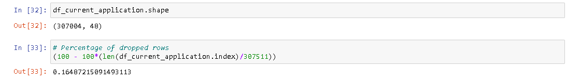
Identify if there are outliers in the dataset
After Further Imputing And removal of Anomaly ,From the Above pic we can see there are another total 16% decrease in the result.

Slide 15
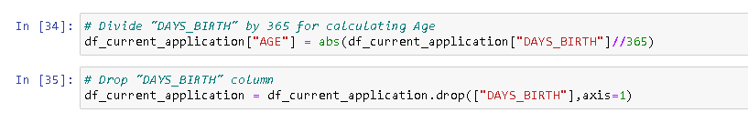
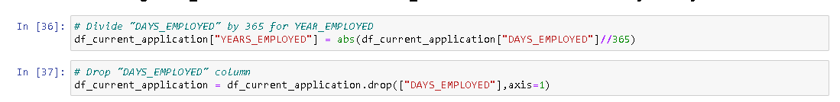
Changing the Date Time frame
Changing the DAYS_BIRTH into days days was essential to get their age and To understand more about the data and same for YEAR_EMPlOYED

Slide 16
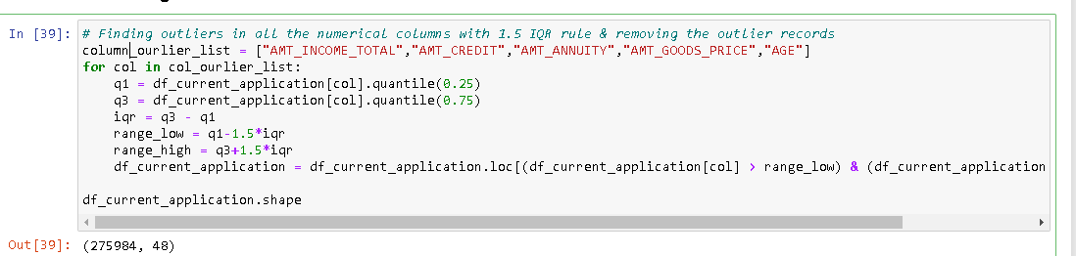
Identify if there is data imbalance in the data
As the requirements of the task we also identified and removed the outliers.

Slide 17
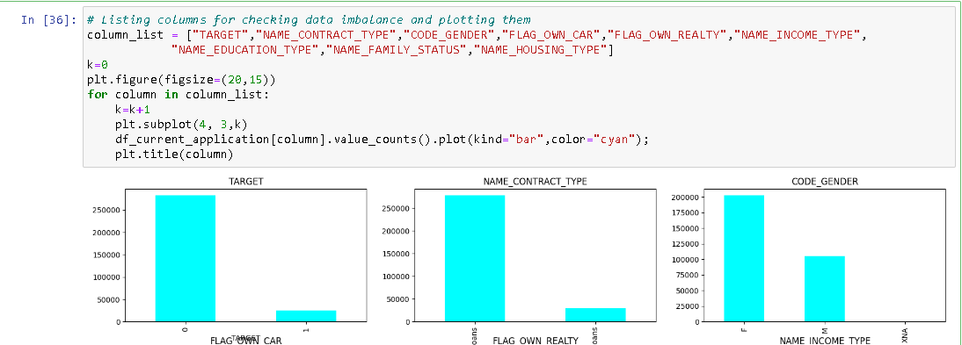
Identify if there is data imbalance in the data

Slide 18
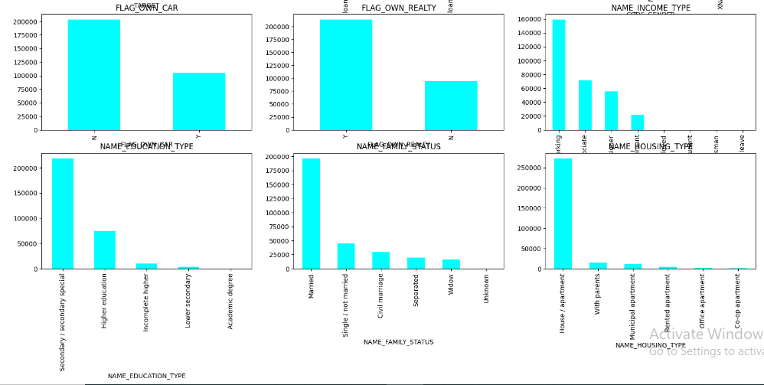
Identify if there is data imbalance in the data

Slide 19
Identify if there is data imbalance in the data
We can see that there is data imbalance found in below columns:-
TARGET - There are negligible amount of defaulters(1) compare to non defaulters(0)
NAME_CONTRACT_TYPE - Very few Revolving loans than Cash loans
NAME_EDUCATION_TYPE – Majority of are loans applied by Secondary/Secondary special educated people
NAME_FAMILY_STATUS - Most of the loans applied by The Married Couples.
NAME_HOUSING_TYPE - Most of the application came from Home owner

Slide 20
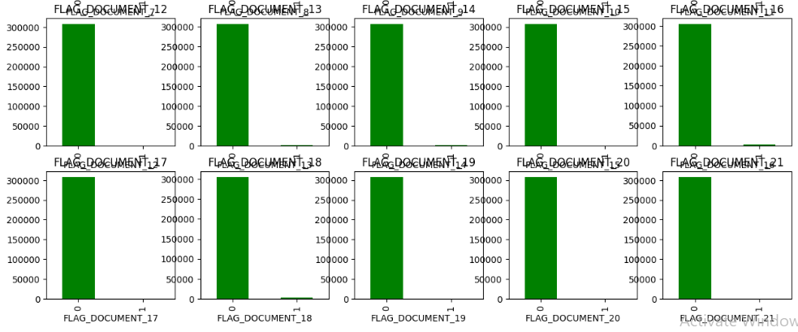
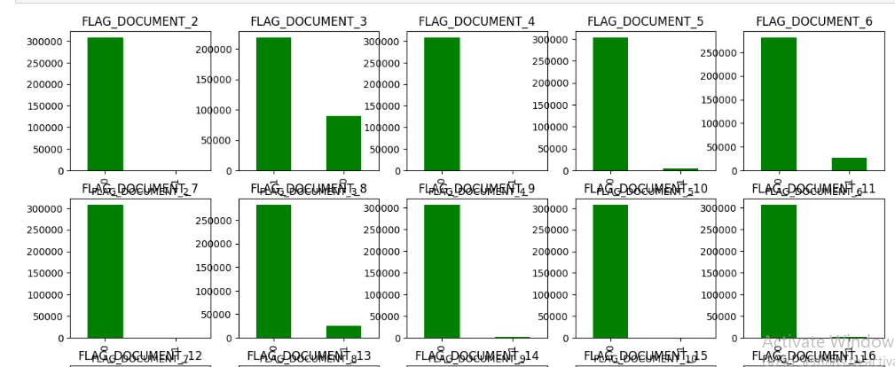
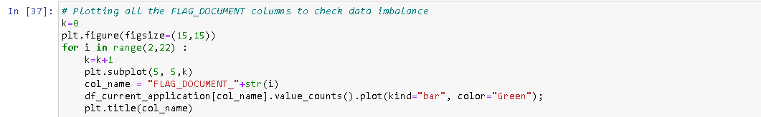
Identify if there is data imbalance in the data
Checking For Imbalance in Data By Plotting Flags.

Slide 21
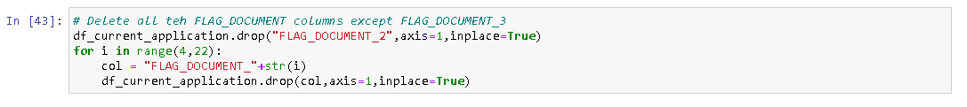
Identify if there is data imbalance in the data
As we can see, the number of 1 in all columns except FLAG_DOCUMENT_3 is an insufficient. Therefore, we will remove all FLAG_DOCUMENT columns except FLAG_DOCUMENT_3.
Removing All The Flag Documents

Slide 22
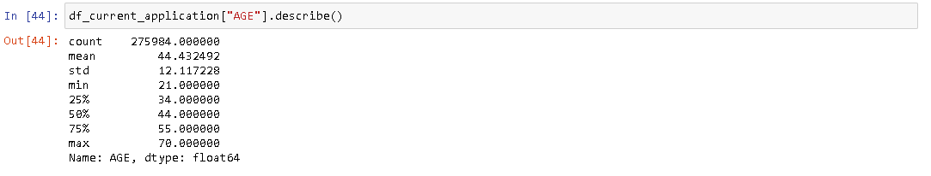
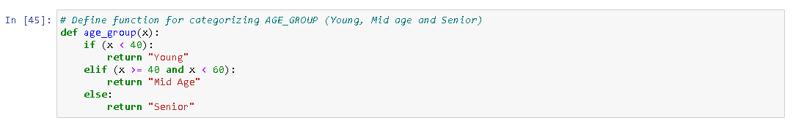
Identify if there is data imbalance in the data

Slide 23
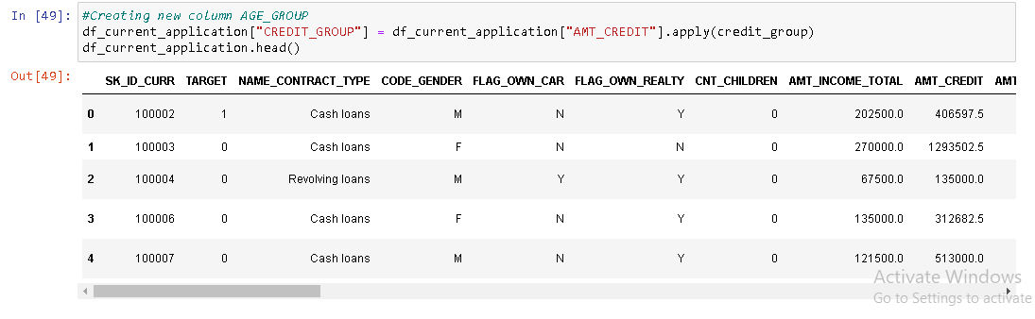
Identify if there is data imbalance in the data
Creating a new age group by with python to categorize people from different ages group

Slide 24
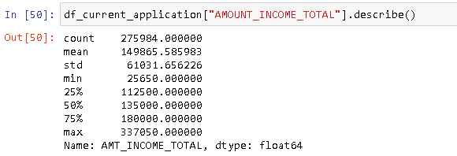
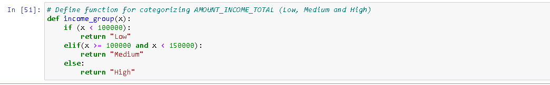
Identify if there is data imbalance in the data

Slide 25
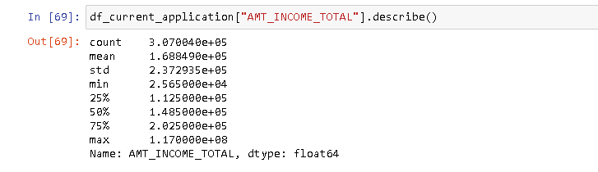
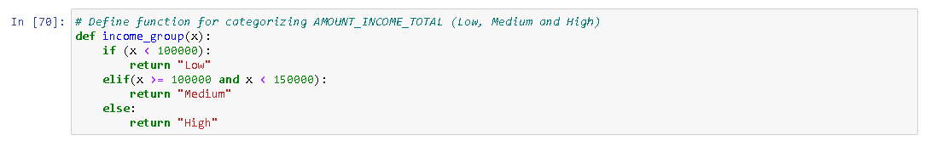
Identify if there is data imbalance in the data

Slide 26
Identify if there is data imbalance in the data
Removing Anomalies From the Gender Result Column

Slide 27
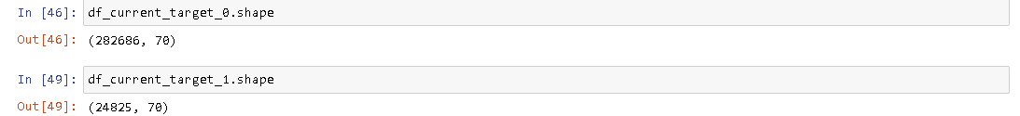
Analyzing Data
Payment difficulties (Target=1); All other cases (Target=0)

Slide 28
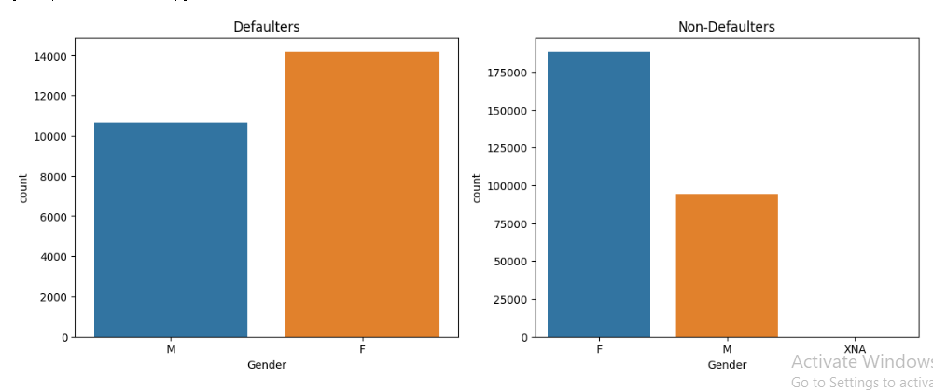
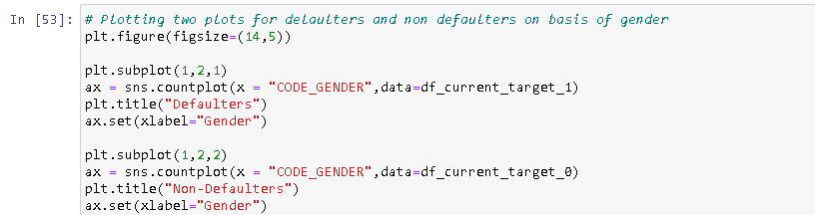
Analyzing Data
For Defaulters - We can see that there are slightly more female clients than male.
For Non-defaulters – The same goes for non-defaulters as well. There are more female clients than male.

Slide 29
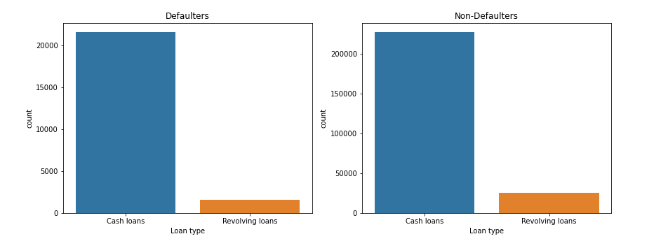
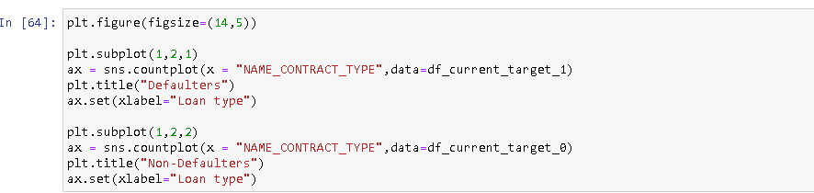
Analyzing Data
We see that in both cases the Revolving or recurrent loans are very less in number compared to Cash loans.

Slide 30
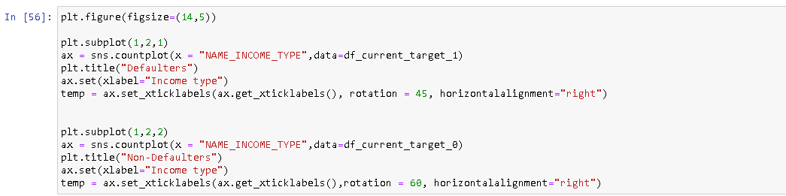
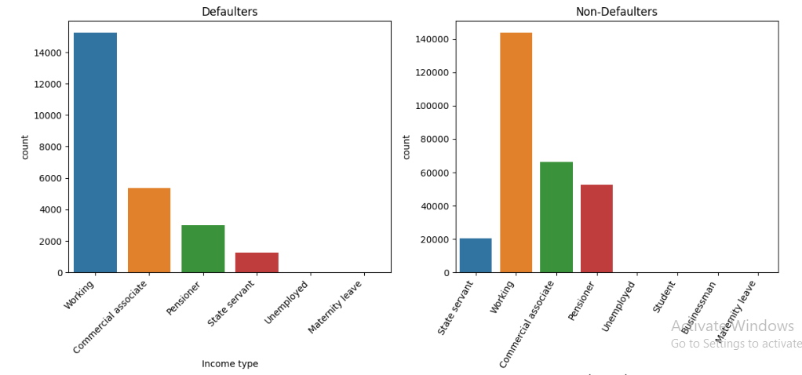
Analyzing Data
Defaulters - Working people are mostly defaulted as their numbers are high in comparison with the Non defaulters.
Non-defaulters - Similarly here also working people are more in number who are not defaulted.

Slide 31
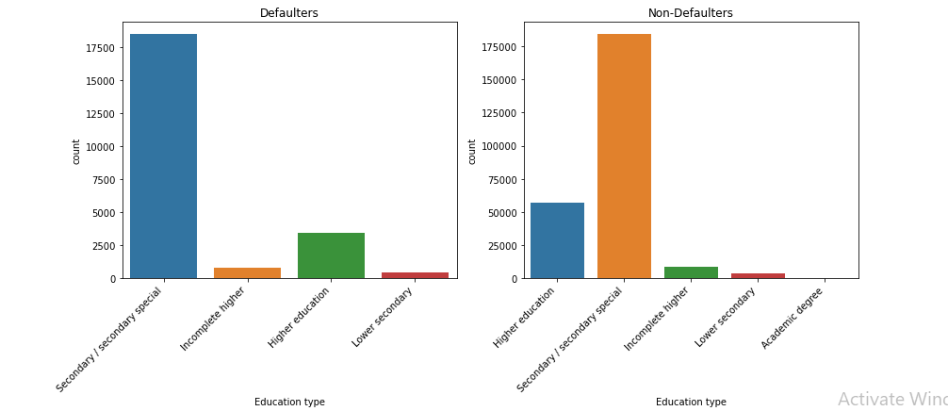
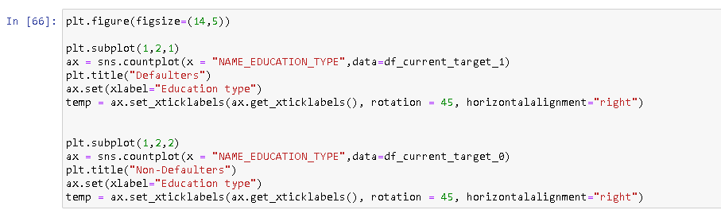
Analyzing Data

Slide 32
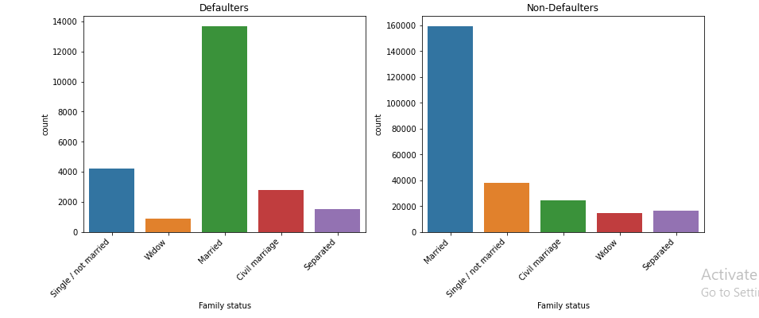
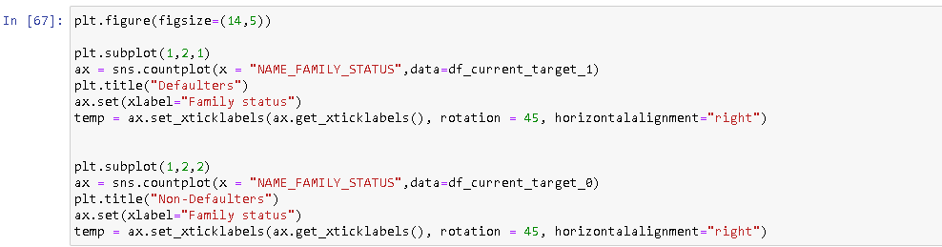
Analyzing Data
For both client group (defaulters and non-defaulters) married couples are more in number compared to single, separated, widow etc.

Slide 33
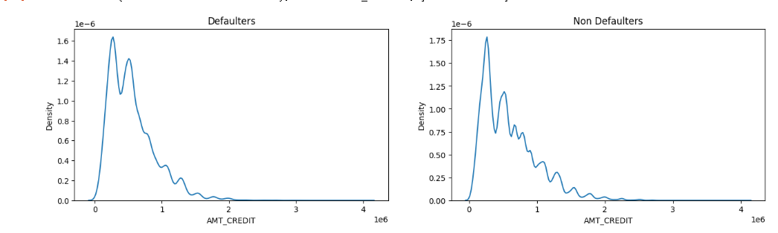
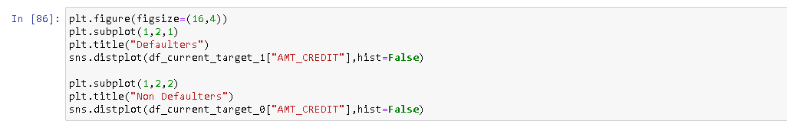
Analyzing Data
Defaulters - We can see that the lesser the amount of the loan, the more chances of being a defaulter. The spike is till 500000.
Non-defaulters - If the credit limit is less, there is lesser chance of being a defaulter. And gradually the chance is being decreased with the loan amount.

Slide 34
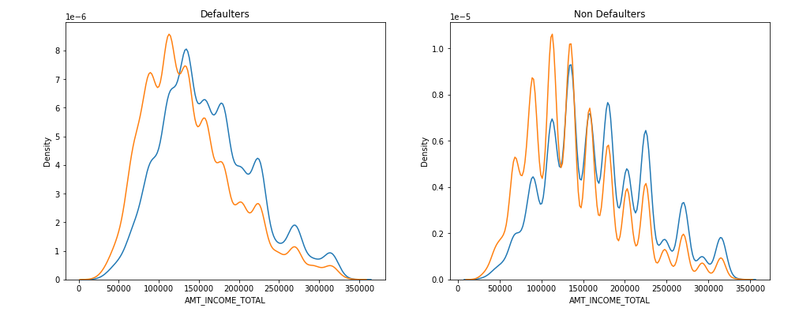
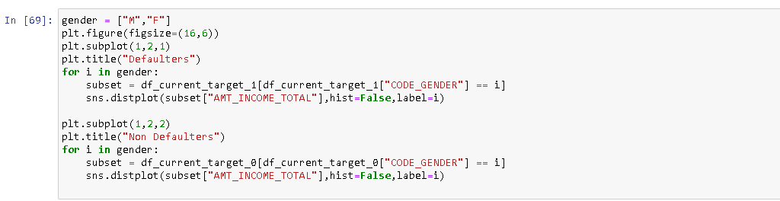
Analyzing Data
Defaulters - We can see that being a defaulter both the genders (male and female) are almost equal in all income groups. The majority of spike, being formed in defaulters are from 50000 to 200000
Non-defaulters – We can see that, Females are more non defaulter on the lower income level but lesser non defaulter in higher income level. The spike is more for both the genders from 75000 to 150000.

Slide 35
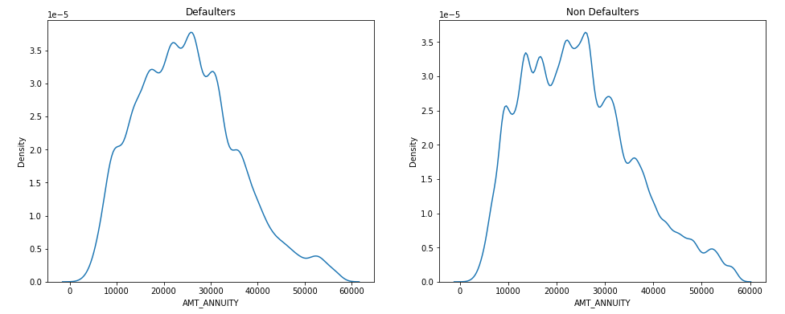
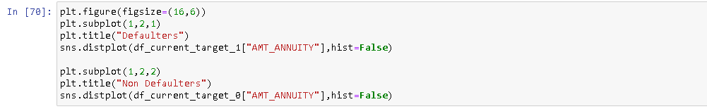
Analyzing Data
We can notice from the above distribution plot that in both the cases the loan annuity is concentrated more from 10000 to 40000.

Slide 36
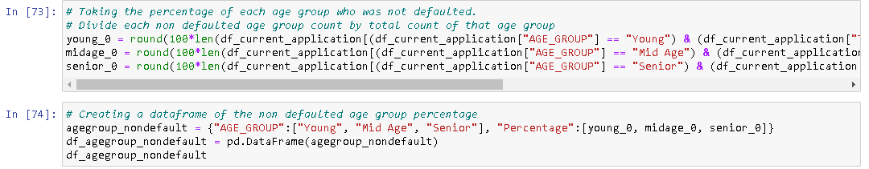
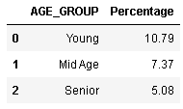
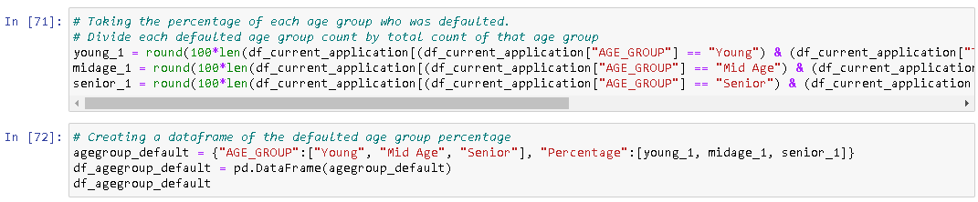
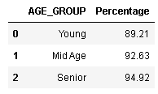
Analyzing Data Percentage of age group applicants defaulted and not defaulted

Slide 37
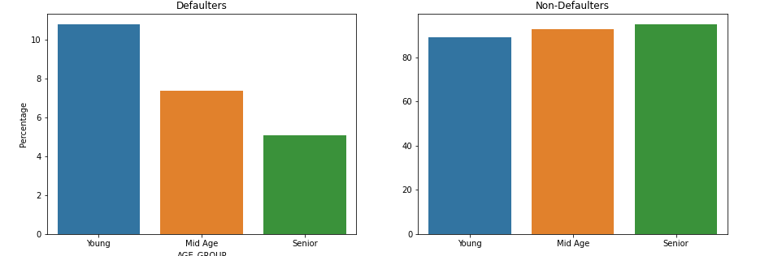
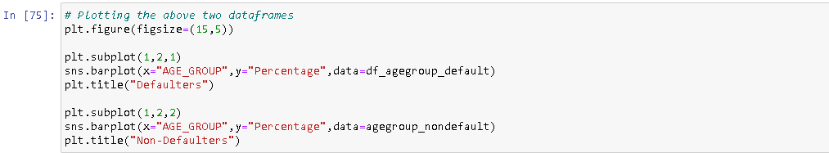
Analyzing Data
Defaulters - We see that Young people are more likely to default than other two age groups. Whereas Senior citizens are less likely to default than others.
Non-defaulters - There is not much difference in the likelihood for non defaulters in the age groups

Slide 38
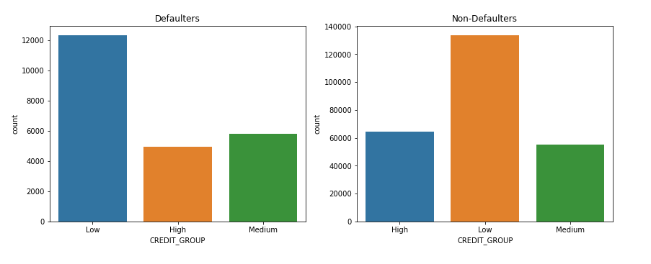

Analyzing Data
Defaulters - Surprisingly, those who fail to pay their low loan debts are those who default more.
Non-Defaults - As expected, the non-default group of credit lines is numerous.

Slide 39


Analyzing Data
Defaulters - Surprisingly, the High-income group is more in number to be defaulted, then Medium and then Low.
Non-defaulters - Here as expected the count of non-defaulters is more in High income group and less in low-income group.

Slide 40


Analyzing Data
Defaulters - low scorer from external data source are more likely to be defaulters. Also, the medium scorer are as likely defaulter as low scorer.
Non-defaulters - Medium scorers are no more defaulted than High scorer. As expected, the Low scorers are lesser in number.

Slide 41

Analyzing Data
Bivariate Analysis
Corelate columns with Higher values for Defaulters.
AMT_CREDIT and AMT_ANNUITY (0.74) AMT_CREDIT and AMT_GOODS_PRICE (0.98) AMT_ANNUITY and AMT_GOODS_PRICE (0.74)

Slide 42

Analyzing Data
Bivariate Analysis
Corelate columns with Higher values for Non-Defaulters
AMT_CREDIT and AMT_ANNUITY (0.76)
AMT_CREDIT and AMT_GOODS_PRICE (0.98)
AMT_ANNUITY and AMT_GOODS_PRICE (0.76)

Slide 43
Analyzing Data
Bivariate Analysis:- Correlation of relevant columns for defaulters & Non_defaulters: Theis two pairs are highly corelated

Slide 44


Analyzing Data
Bivariate analysis on continuous variable

Slide 45


Analyzing Data
Bivariate analysis on continuous variable-
We see that the greater number of enquiries the lesser the amount of loan credited for both defaulters and non defaulters.

Slide 46

Analyzing Data
Bivariate analysis on continuous variable(Defaulters)

Slide 47

Analyzing Data
Bivariate analysis on continuous variable (Defaulters)

Slide 48

Analyzing Data
Bivariate analysis on continuous variable(Defaulters)

Slide 49


Analyzing Data
Bivariate analysis on continuous variable(Defaulters)

Slide 50


Analyzing Data
Bivariate analysis on continuous variable(Non-Defaulter)

Slide 51

Analyzing Data
Bivariate analysis on continuous variable(Non-Defaulter)

Slide 52

Analyzing Data
Bivariate analysis on continuous variable(Non-Defaulter)

Slide 53

Analyzing Data
Bivariate analysis on continuous variable(Non-Defaulter)
difference between genders, client owning cars or property has no credit limit available
Higher income group have more loan amount provides and vice versa for lower income group.
Clients with more score(CIBIL etc.) have more loan amount.
Married couples got greater amount of loan provided to them.

Slide 54

Analysis of two segmented variables
We can see that Males are more likely defaulted than Females across all income groups

Slide 55

Analysis of two segmented variables
Lower secondary educated clients are more defaulted followed by Secondary and Incomplete higher educated clients. The Higher educated people are less defaulted.
Across all educated level Females are less defaulted than male.

Slide 56

Analysis of two segmented variables
Medium credit amount group are highly defaulted in all income groups.
High credit amount groups are less likely to default in all income groups.

Slide 57

Analysis of two segmented variables
Young clients with medium and low credit amount group are highly defaulted.
Senior citizens across all credit amount groups are less likely defaulted.

Slide 58

Analysis of two segmented variables
Young clients are more defaulted than Mid age and senior.
Young low-income people are more defaulted.
For Mid age and senior people, the default rate is almost same in all income group.

Slide 59

Analysis of two segmented variables
No surprise the unemployed clients are more defaulted.
Clients with maternity leave are expected to be defaulted more.
The default rate is lesser in all other professions.
Males are more defaulted with their respective professions compared to females.

Slide 60

Anslysis of two segmented variables
Across all family status the clients from ‘Young’ age group are more defaulted and Senior citizen.

Slide 61

Anslysis of two segmented variables
After importing previous application dataset, and after dropping unnecessary columns with 40% missing value
After that outliers are removed.
After the cleaning and identifying is done we have dropped 25.63% rows from the dataset.

Slide 62



Analyzing Data (Checking data imbalance for previous application data: )
NAME_CONTRACT_TYPE - There are very few Revolving Loan
NAME_CONTRACT_STATUS - There are very few Refused loans. Almost negligible Canceled loans.
NAME_CLIENT_TYPE - There are very few New applicant. Even fewer Refreshed applicants.
NAME_PORTFOLIO - Very few application for Cards and Cars
CHANNEL_TYPE - Except Country-Wide, Credit and Cash offices and Stone all other channels are very few.

Slide 63
Analyzing Data
Converting DAYS_DECISION column into MONTH_DECISION column for readability and analysis:

Slide 64

Analyzing Data (Merging Current application and Previous application dataset:)

Slide 65

Analyzing Data (Merging Current application and Previous application dataset:)
There are Null values in the current application columns in the merged datasets. Because few SK_ID_CURR are present in the previous application dataset, but those IDs are not present in the current application dataset.
We can create a new derived column for what percentage of the applied amount was credited for each client. Derived column name :- PERCENT_CREDIT

Slide 66

Analyzing Result Data
Univariate analysis on unordered categorical variable:
There are huge number of Approved loan than Refused. Hardly, there are any Canceled or Unused offer loan.

Slide 67

Analyzing Result Data
Univariate analysis on unordered categorical variable
Mostly the applicants were Recurrent.

Slide 68

Analyzing Result Data
Univariate analysis on unordered categorical variable
The highest number of the previous applications was for POS. Applications for Cash also has good number. Applications for Cards were very few.

Slide 69

Analyzing Result Data
Univariate analysis on unordered categorical variable

Slide 70

Analyzing Result Data
Univariate analysis for continuous variables:
Most of the applications were for below 250000 as we see from the above distribution.

Slide 71

Analyzing Result Data
Univariate analysis for continuous variables:
We can see that most of the applications decision took approximately 30 months. The time taken spread up to 100 months.

Slide 72

Analyzing Result Data
Bivariate Analysis:
Highly corelate columns -
AMT_APPLICATION and AMT_CREDIT
AMT_APPLICATION and AMT_ANNUITY
AMT_CREDIT and AMT_ANNUITY
Moderately corelated columns -
AMT_APPLICATION and CNT_PAYMENT
AMT_CREDIT and CNT_PAYMENT

Slide 73

Analyzing Result Data
Bivariate Analysis On Continues Variable:
We can see that the applications are more concentrated on the lesser amount and so as the credited amount. Also, the credited amount is increased with respect to the application amount.

Slide 74

Analyzing Result Data
Bivariate Analysis On Continues Variable:
We can see a pattern here that the more the application amount of the loan, the lesser the months taken prior to current application. That means, most of the higher amount of the loan application decision made in the recent time compared to the lower loan amount application.

Slide 75

Analyzing Result Data
Bivariate Analysis On Categorical Variable:

Slide 76

Analyzing Result Data
Bivariate Analysis On Categorical Variable:

Slide 77
Analyzing Result Data
Bivariate Analysis On Categorical Variable:
Cash_loan are more credited in amount than Recurrent and Consumer loans.
Return clients get more loan amount than new and refreshed clients.
The Car loans get more amount credited followed by Cash.
The credit amount of the loan is more from the application channel type as car dealer followed by Channel of corporate sales, Credit and cash offices and Contact center. The amount is very less for Regional, Stone and Country-wide channels

Slide 78

Analyzing Result Data
Analysis of two segmented variables:
We see that the Repeater clients have more approved loans than New and Refreshed clients.

Slide 79

Analyzing Result Data
Analysis of two segmented variables:
We see that previously Refused or cancelled client is more defaulted than previously Approved clients. Also, in all the cases the Males are more defaulted than Females.

Slide 80

Analyzing Result Data
Analysis of two segmented variables:
We can see that the Defaulters are more for previously Unused offers loan status clients, who were New.
For previously Approved status the New clients were more defaulted followed by Repeater.
For previously Refused applicants the Defaulters are more Refreshed clients.
For previously Canceled applicants the Defaulters are more New clients.

Slide 81


Analyzing Result Data
Analysis of two segmented variables:
For all the previous status Young applicants are more defaulted.
For all the previous status Senior applicants are less defaulted compared to others.

Slide 82


Analyzing Result Data
Analysis of two segmented variables
For previously Unused offer the Medium income group was more defaulted and Low-income group is the least.
For other application status all the income groups are equally defaulted.

Slide 83

Analyzing Result Data
Analysis of two segmented variables
Most of the clients were defaulted, who previously applied loan for Cards.
For approved loan status the clients applied for Cars are less defaulted.
For Refused loan status the clients applied for POS are less defaulted.

Slide 84

Analyzing Result Data
Analysis of two segmented variables
Applicants with low external source score are highly defaulted.
Higher scorer applicants are very unlikely to default irrespective of their previous loan status.

Slide 85
Conclusion
Most Recommended Groups:-
. Highly educated clients with higher income.
Clients with higher external source score.
Senior citizens in all categories.
Married couples compared to other family status.
Working Female more than males.
Least Recommended Groups:-
Previously Refused, Cancelled Clients.
Clients from Low-income group.
Unemployed clients.
Lower Educated Peoples.
Clients with low external source score.

Slide 86

Thank You

